Slide 1
Cardiovascular Disease Classification
Group 5:
Ankit Malhotra, Nathaniel Zhu, Hong Khanh Che

Slide 2
Table of contents
01
02
03
04
05
06
Statement
Data Overview
Data Preparation
Data Visualization
Data Analysis
Conclusion

Slide 3
Statement
01

Slide 4

Our Purpose
Achieve Goals in This Dataset
Disease Prediction
Risk Factor Identification

Slide 5

Our Purpose Beyond!
Achieve Goals Beyond This Dataset
Disease Awareness and Surveillance
Disease Prediction with One’s Physical Facts with Medication
Health Policy Development
Notes:
Disease Awareness and Surveillance: We can talk more about the facts about this disease and use the data for monitoring trends in cardiovascular disease incidence, prevalence, and mortality over time, which is crucial for public health surveillance and planning.
Possible Prediction and
Health Policy Development: The insights gained from analyzing the CVD dataset can also contribute to the development of health policies aimed at reducing the burden of cardiovascular diseases.

Slide 6
Data Overview
02

Slide 7

Defining the dataset
The "Cardiovascular Disease Dataset" focuses on identifying the presence of cardiovascular diseases. It contains:
Total Variables: 13
Key Dependent Variable: 'cardio'
Value '1': Indicates cardiovascular disease
Value '0': Indicates no cardiovascular disease
This structured dataset aims at facilitating analysis and predictive modeling in cardiovascular health research.

Slide 8
70,000
13
Records of patients data
Variables

Slide 9
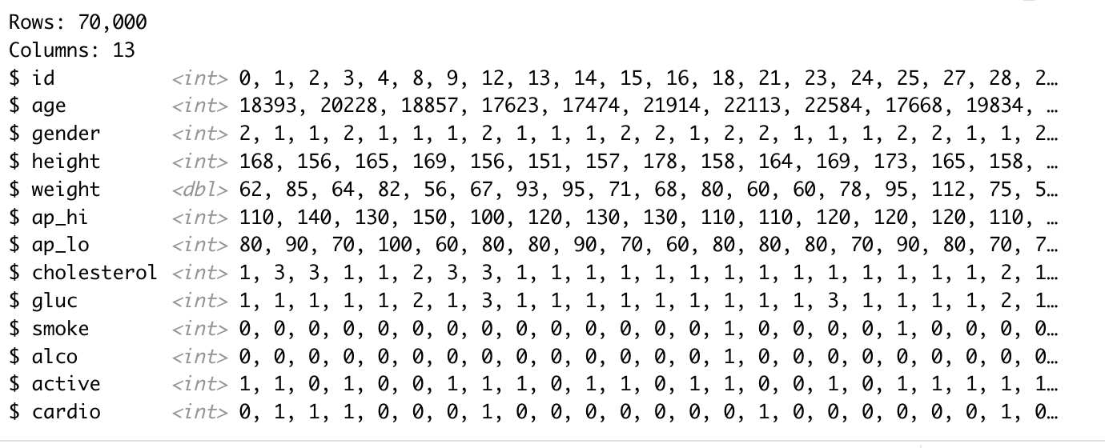
A Glimpse of the Dataset

Slide 10
A Glimpse of the Dataset (cont.)
Age | Objective Feature | int (days)
Gender | Objective Feature | categorical code
Height | Objective Feature | int (cm)
Weight | Objective Feature | float (kg)
Ap_hi | Systolic blood pressure Examination Feature | int
Ap_lo | Diastolic blood pressure | Examination Feature | int
Cholesterol | Examination Feature | 1: normal, 2: above normal, 3: well above normal
Gluc | Glucose | Examination Feature | 1: normal, 2: above normal, 3: well above normal
Smoke | Smoking | Subjective Feature | binary
Alco | Alcohol intake | Subjective Feature | binary
Active | Physical activity | Subjective Feature | binary
Cardio | Presence or absence of cardiovascular disease | Target Variable | binary
Objective: factual information;
Examination: results of medical examination;
Subjective: information given by the patient.

Slide 11
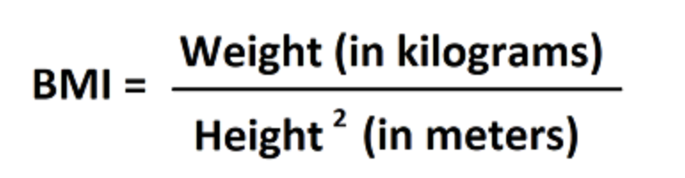
03
Data Preparation
Transform:
Female = 1 → 0
Male = 2 → 1
Transform:
Age in days → Age in years
Create a new variable called BMI
Filter out id, age in days and height
Check outliers for numerical variables
Remove outliers for ap_hi and ap_lo

Slide 12
Data Visualization
04

Slide 13
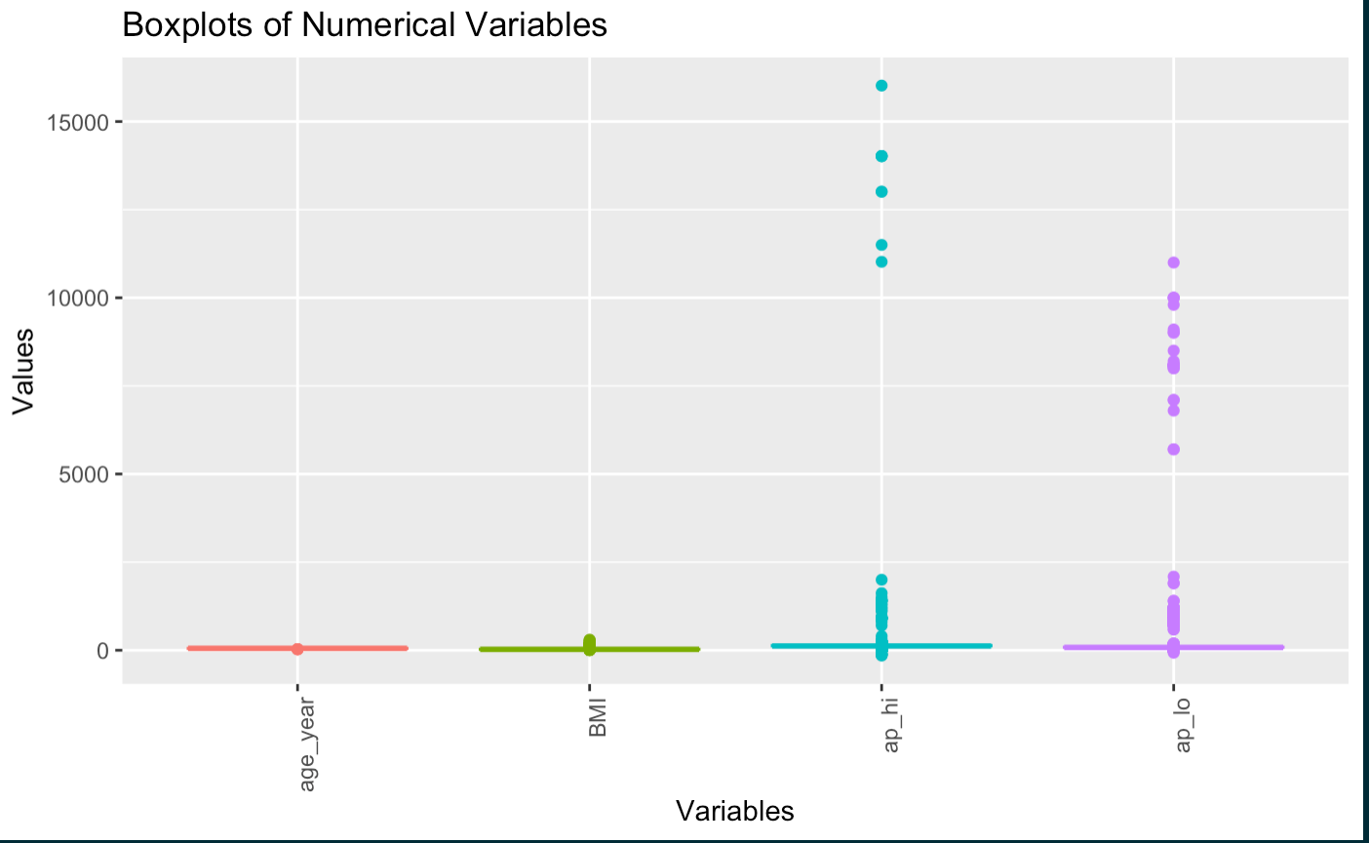
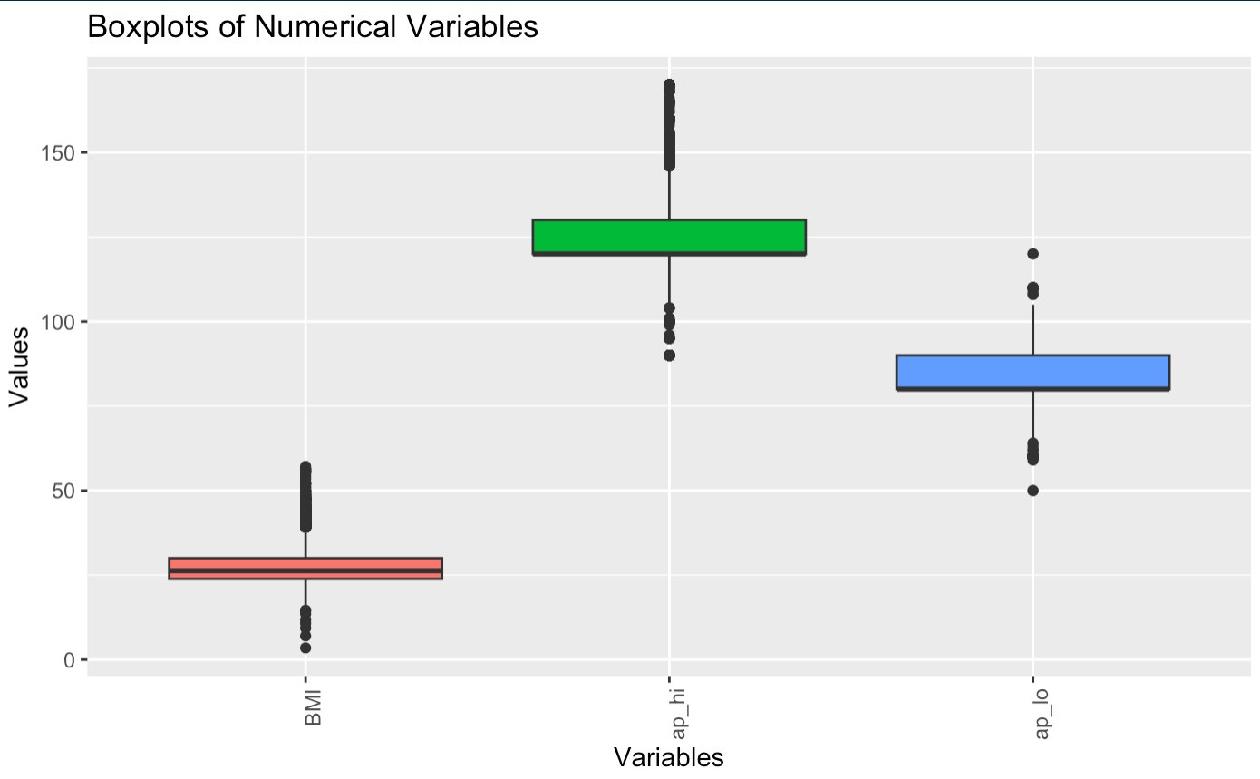
Numerical Predictors - Checking outliers
→
There are significant outliers with values up to more than 5000 for ap_lo and over 10000 for ap_hi. This is unreasonable for normal Diastolic Blood Pressure and Systolic blood pressure ranges.
According to the CDC, systolic pressure should be less than 120 mm Hg for normal levels, and diastolic pressure should be less than 80 mm Hg. For at-risk level, systolic is 120–139 mm Hg and diastolic: 80–89 mm Hg. For high blood pressure (hypertension), systolic is 140 mm Hg or higher, and diastolic is 90 mm Hg or higher.
Therefore, we eliminated these outliers to obtain more reliable data for further analysis

Slide 14
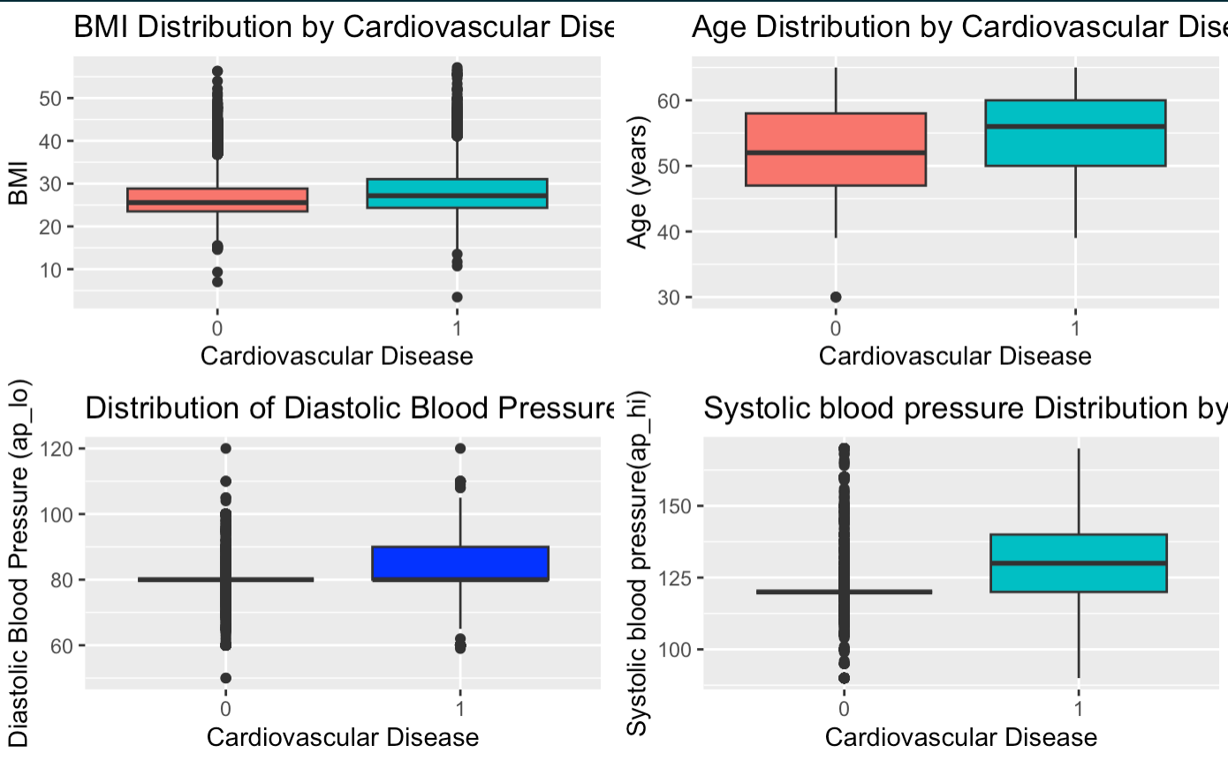
Numerical Predictors - Checking outliers (cont.)
BMI: the mean BMI of those examined with the absence of cardiovascular disease is lower than that of those examined with the presence of cardiovascular disease.
Age: The mean age of patients at higher risk of cardiovascular disease is higher than that of patients without cardiovascular disease.
Ap_lo: The mean diastolic blood pressure disease for those with either the absence or presence of cardiovascular disease is the same.
Ap_hi: The mean systolic blood pressure for those with a disease is higher than for those without disease.

Slide 15
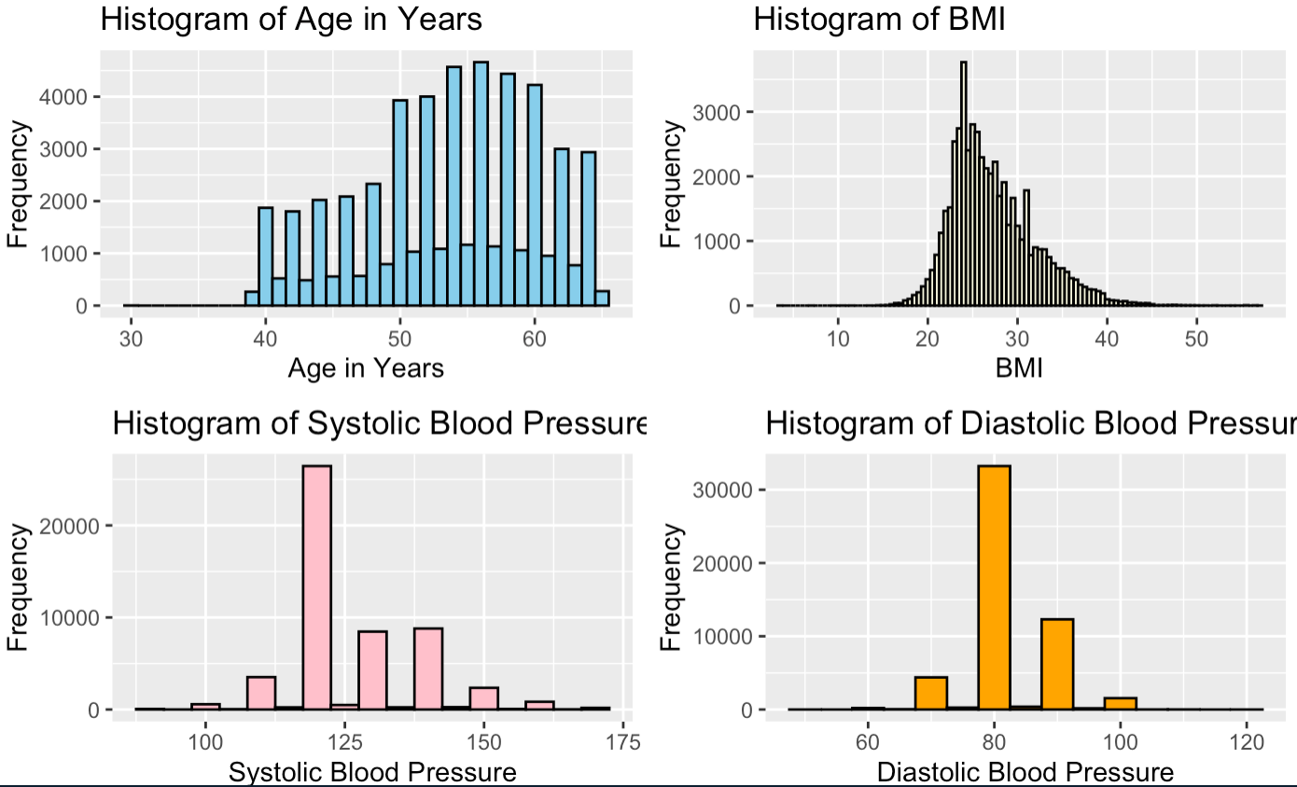
Numerical Predictors - Distribution
Age: A left-skewed distribution, meaning there are more young individuals than older ones in the dataset. Most individuals are between 50 and 60 years old.
BMI: The distribution is right-skewed and centered around a BMI of around 30. There are few very low or very high BMI values, as indicated by the tails of the distribution.
Systolic Blood Pressure: The distribution is right-skewed, with more individuals having higher systolic blood pressure.
Diastolic Blood Pressure: The distribution of diastolic blood pressure is right-skewed, with the highest frequency at around 80 mmHg. There are smaller peaks at around 60 mmHg and 100 mmHg.

Slide 16
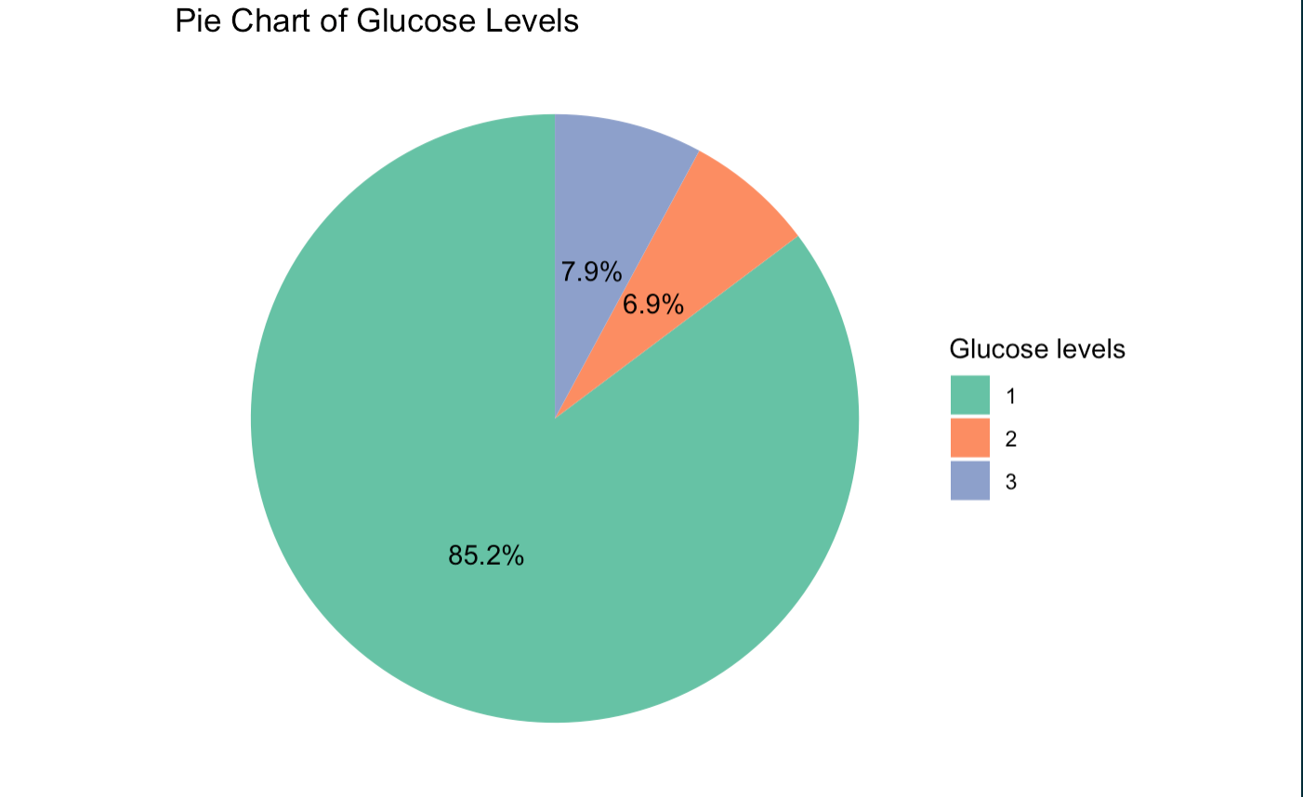
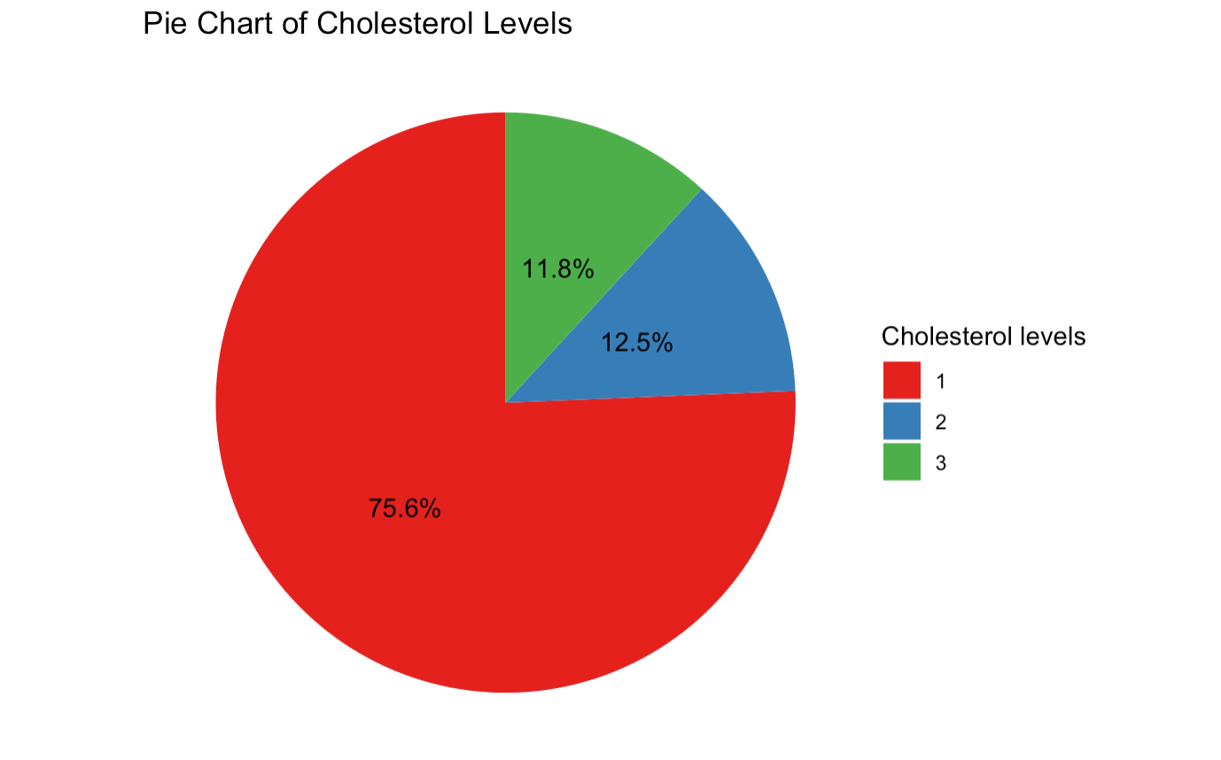
Categorical Predictors - Distribution
Overall, we see that the number of patients with normal cholesterol levels accounts for 75.6%, a big difference from the remaining two. Likewise, the normal glucose level accounts for up to 85.2%, followed by well above the normal level of 7.9%.

Slide 17
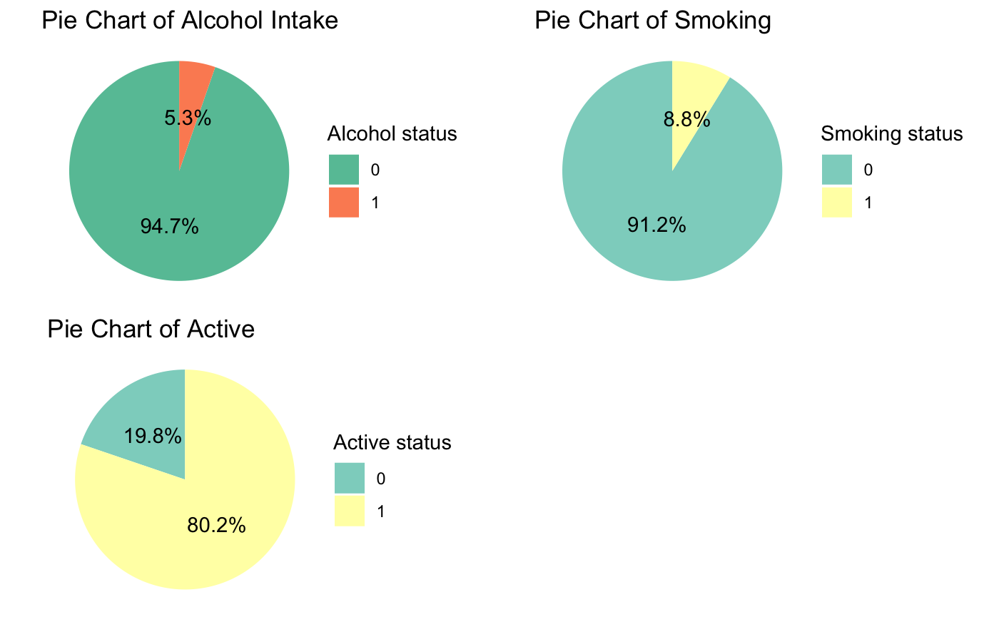
Categorical Predictors - Distribution (cont.)
The percentage of patients who report they do not smoke is 91.2%, and 94.7% do not drink alcohol. Next, the rate of patients who think they are active also accounts for 80.2%.

Slide 18
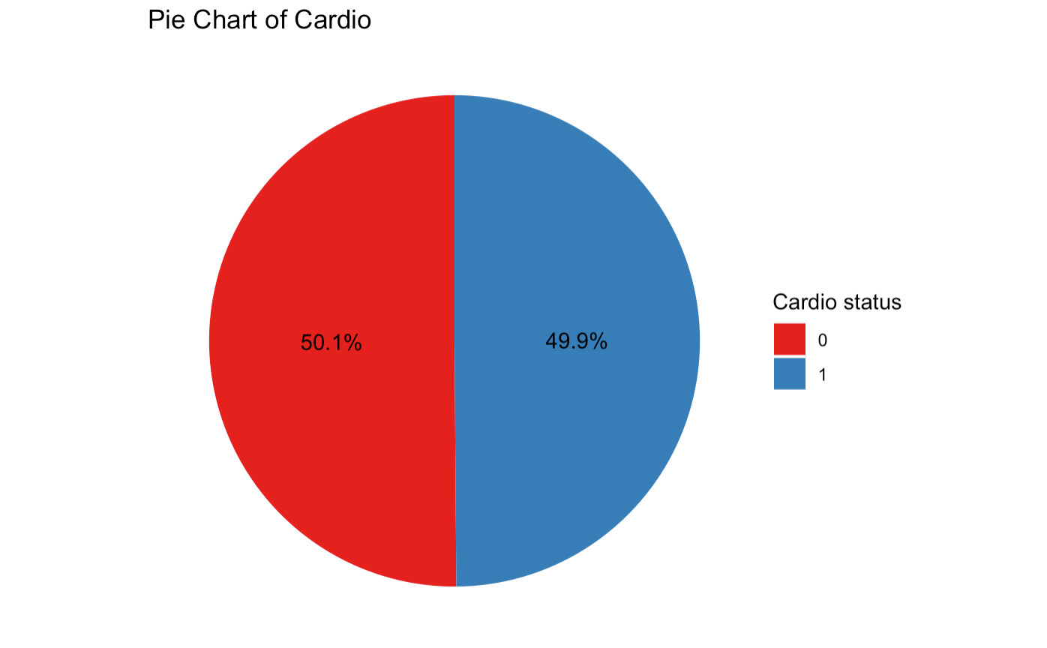
Categorical Predictors - Distribution (cont.)
In summary, the number of people at risk of cardiovascular disease is 50.1%, not far away from the number of people not at risk of disease, 49.9%. Overall, the findings from this data show that most patients have a healthy lifestyle with a healthy diet and are physically active. However, the prediction results show that the number of people at risk of getting disease or not is not much different.

Slide 19
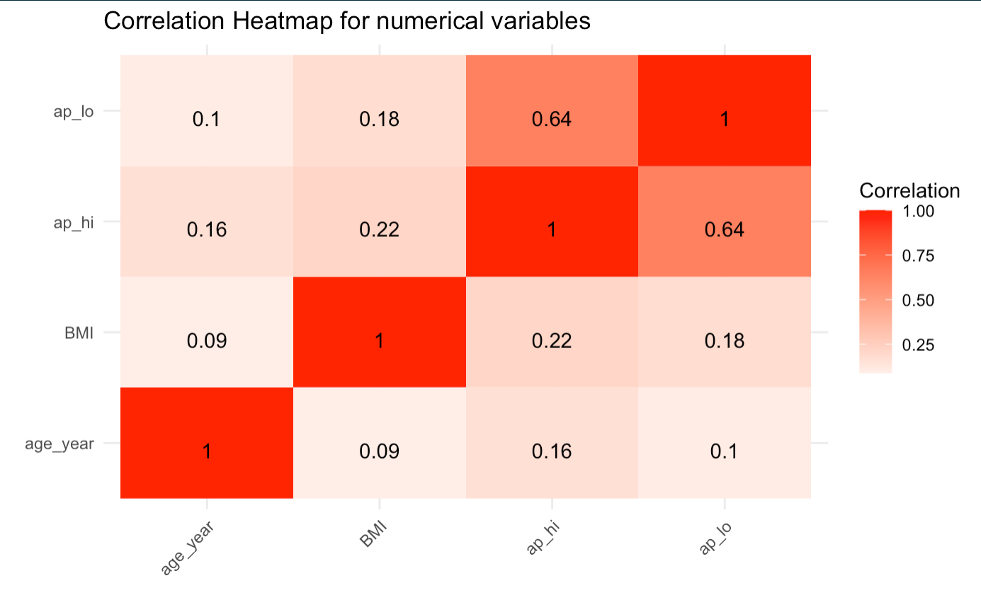
Correlation heatmap for numerical predictors

Slide 20
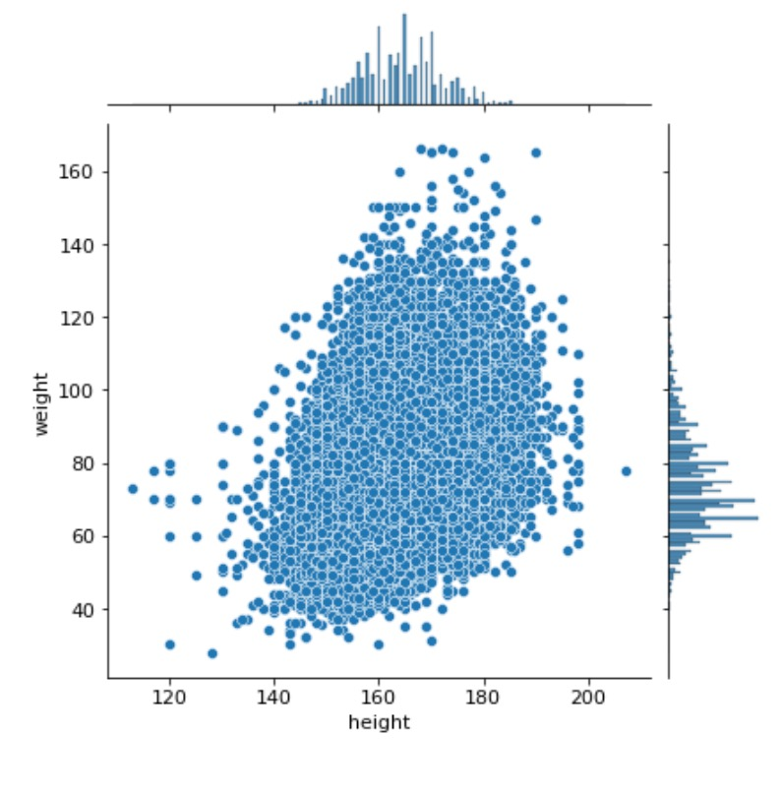
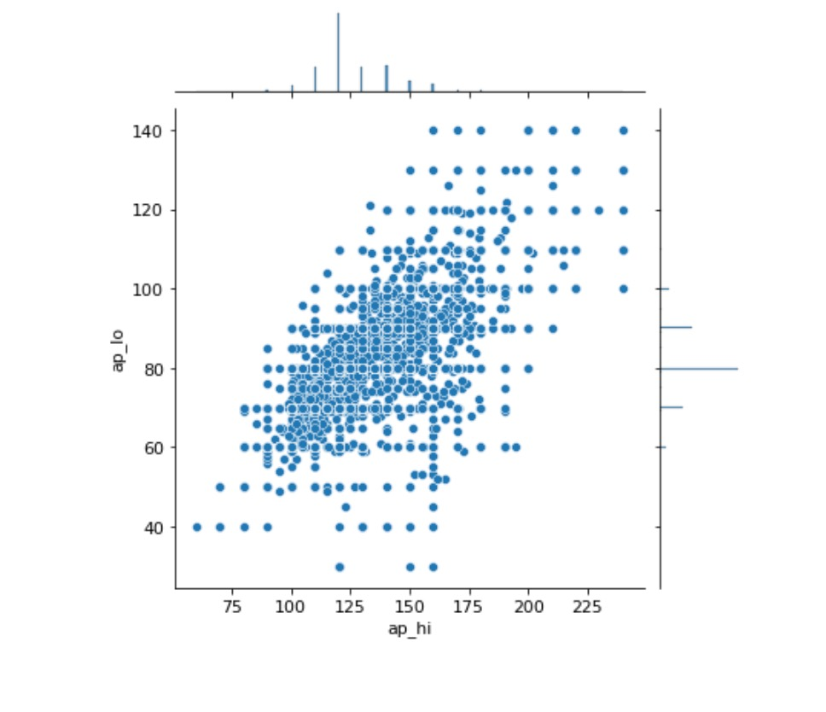
Numerical Predictors - Correlation
There is bound to be a positive correlation between height | weight and systolic | diastolic blood pressure values as they go hand in hand.

Slide 21
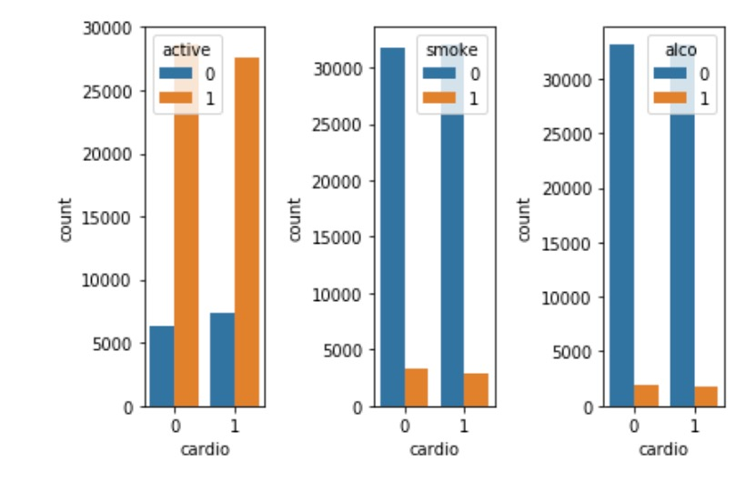
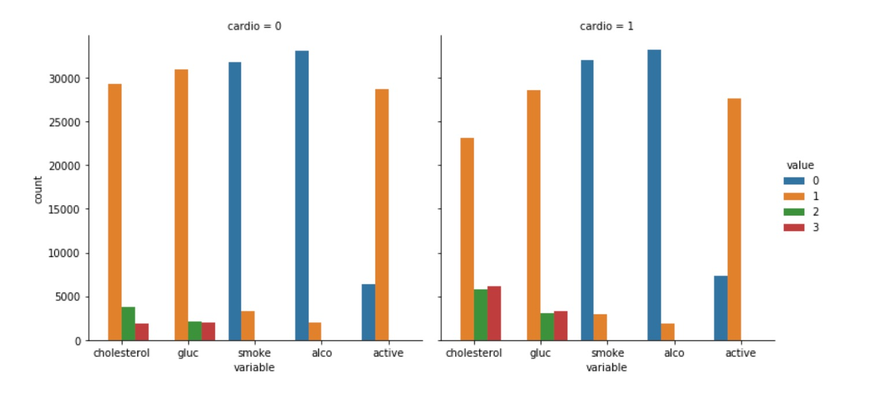
Categorical Predictors - Distribution (cont.)
Notes:
Active people still getting cardiovascular diseases. So is it actually a good measure?
Apparently non-smokers are more prone to cardiovascular diseases but it’s not entirely true.
Also it shows that people not drinking alcohol also are involved in cardiovascular diseases. So obviusly these would not be the only necessary measures for evaluation.

Slide 22
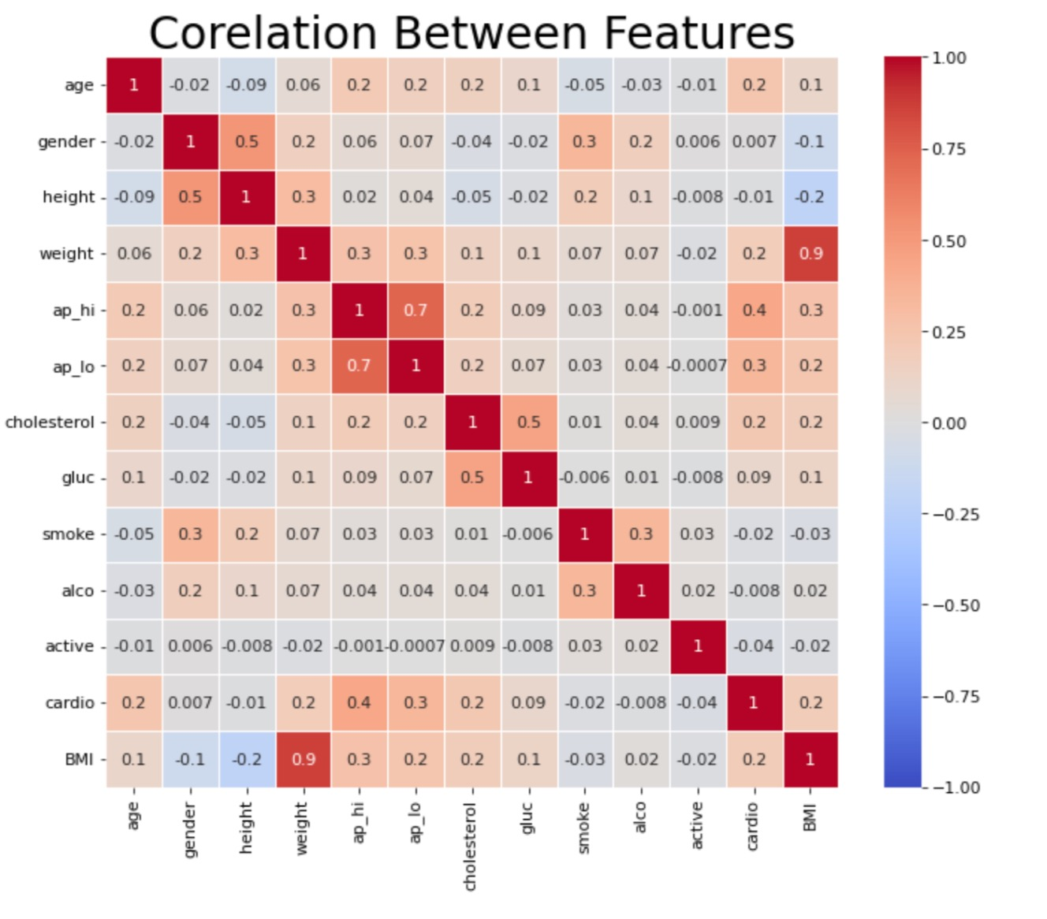
Correlation heatmap for all variables

Slide 23
Data Modeling
05

Slide 24
set.seed(1997) # Set the seed for reproducibility
train_index <- createDataPartition(cardio_clean$cardio, p = 0.7, list = FALSE)
train_data <- cardio_clean[train_index, ]
test_data <- cardio_clean[-train_index, ]

Slide 25
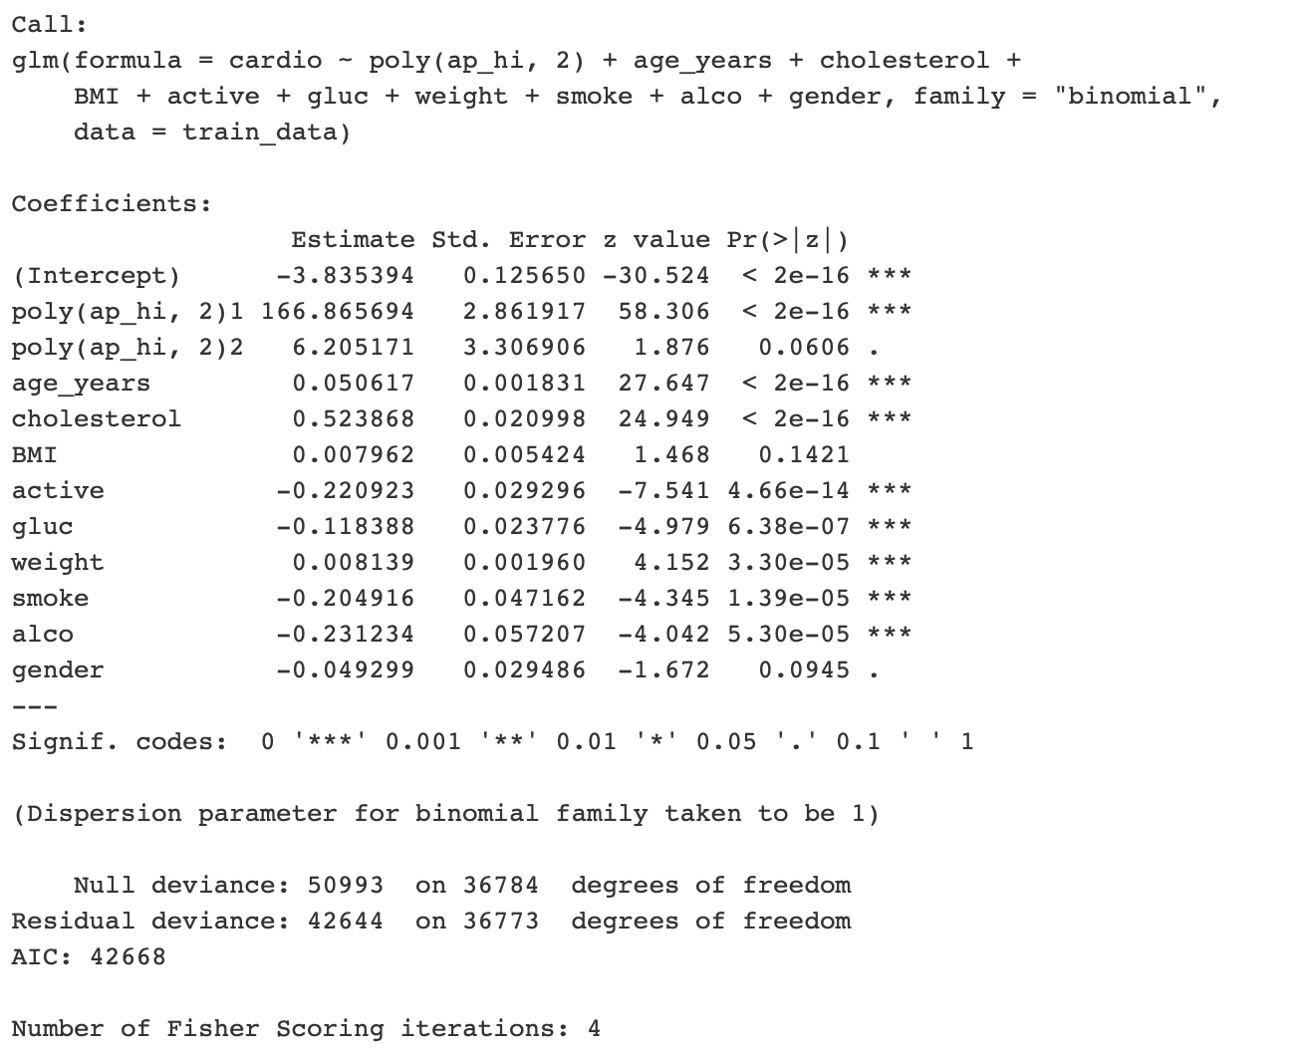
cardio ~ poly(ap_hi,2) + age_years + cholesterol + BMI + active + gluc + weight + smoke + alco + gender
Logistic Regression + Backward
Accuracy : 70.87%
AIC: 42667.64

Slide 26
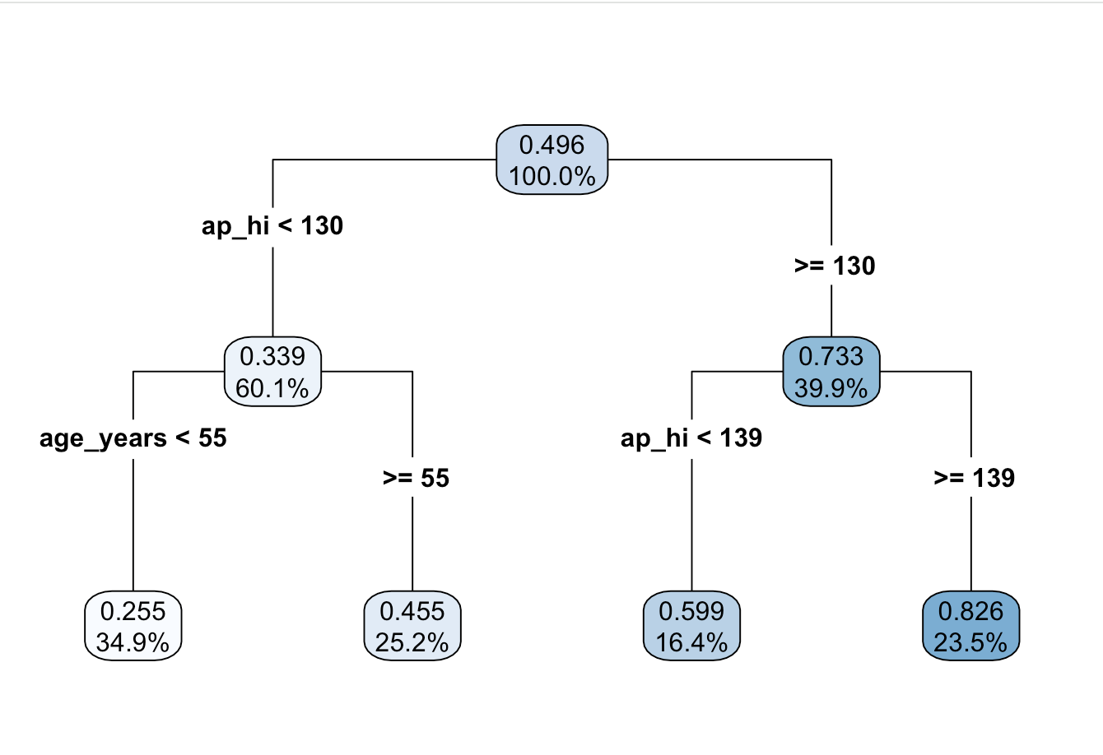
Decision Tree
rpart(formula = cardio ~ ., data = cardio_clean, subset = train)
Node number 7:
n = 6184 obs
mean=0.8256792MSE=0.1439331

Slide 27
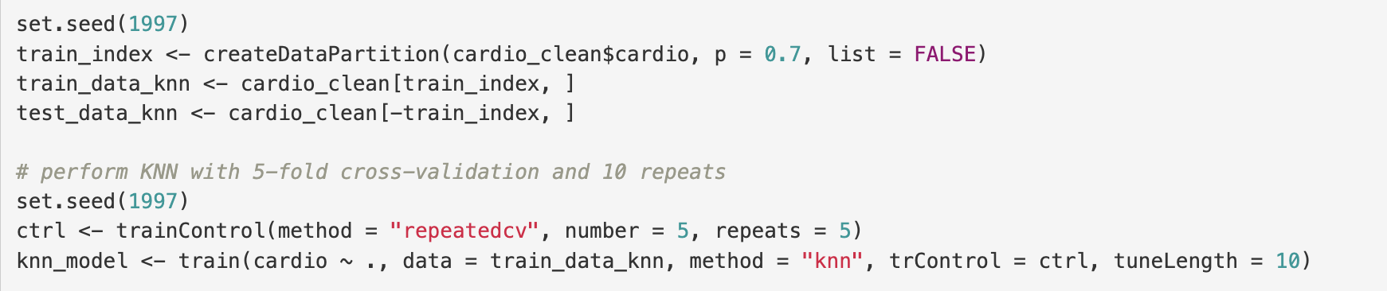
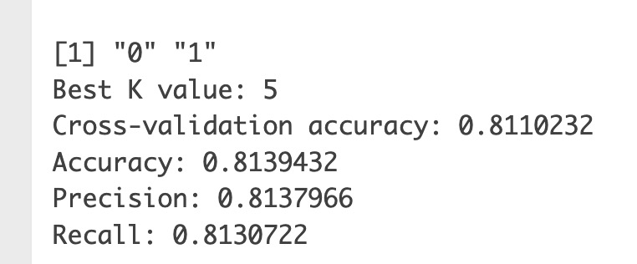
Accuracy : 81.1%
KNN
Cardio with all variables
p = 0.7
K-folds = 5

Slide 28
Conclusion
06

Slide 29
Future Scope
More to classification :
SVMs
SVC
Implementation of Neural Networks
Multi-Class Classification : Gathering more information on the data, for e.g. type of cardiovascular diseases etc.
Integrating with physical Devices : Using more data and models from physical devices as well as people / customer, we can use this as an aid to nurses / doctors.

Slide 30
Thank you for listening

